Slide 1
Pre-stressed Concrete Beams

Slide 3
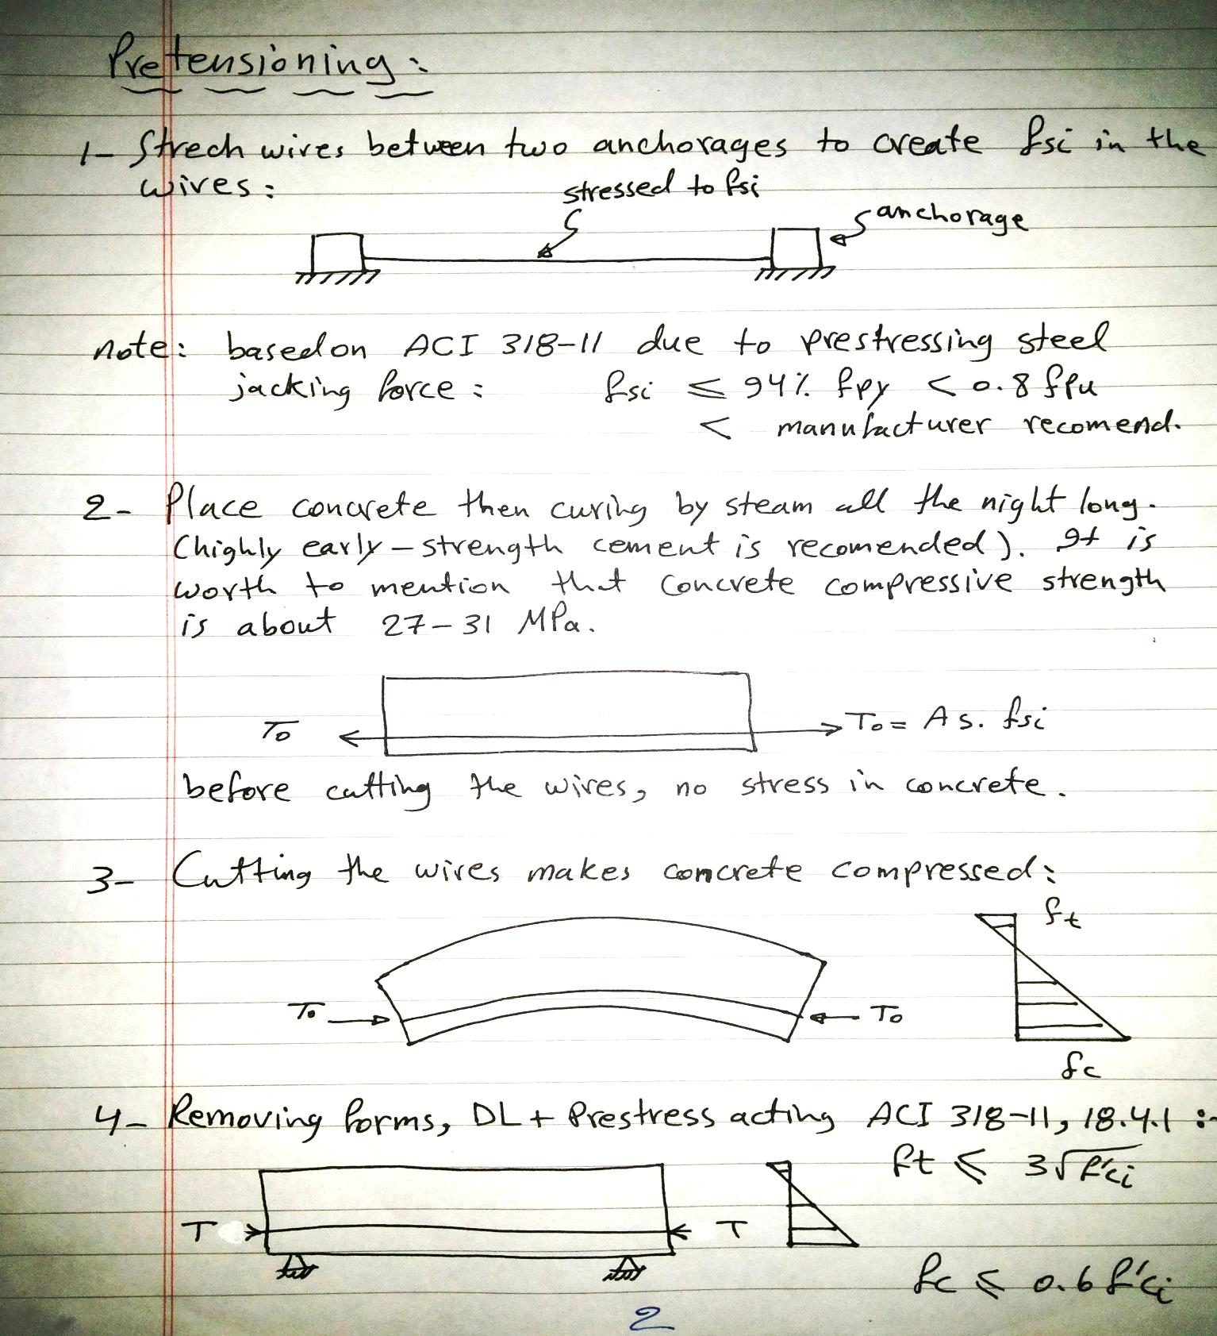

Slide 4
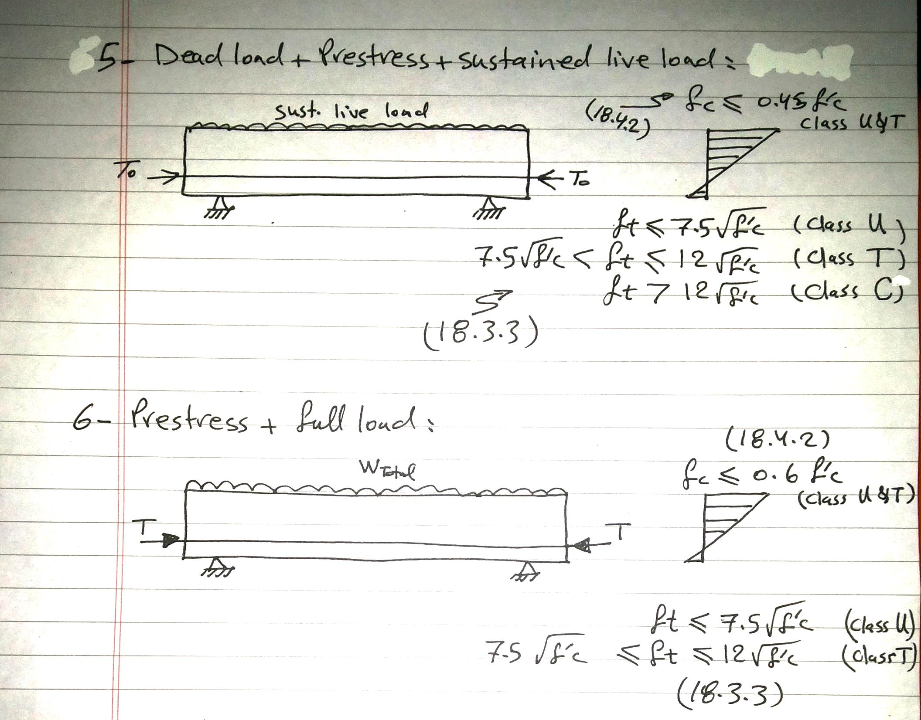

Slide 5
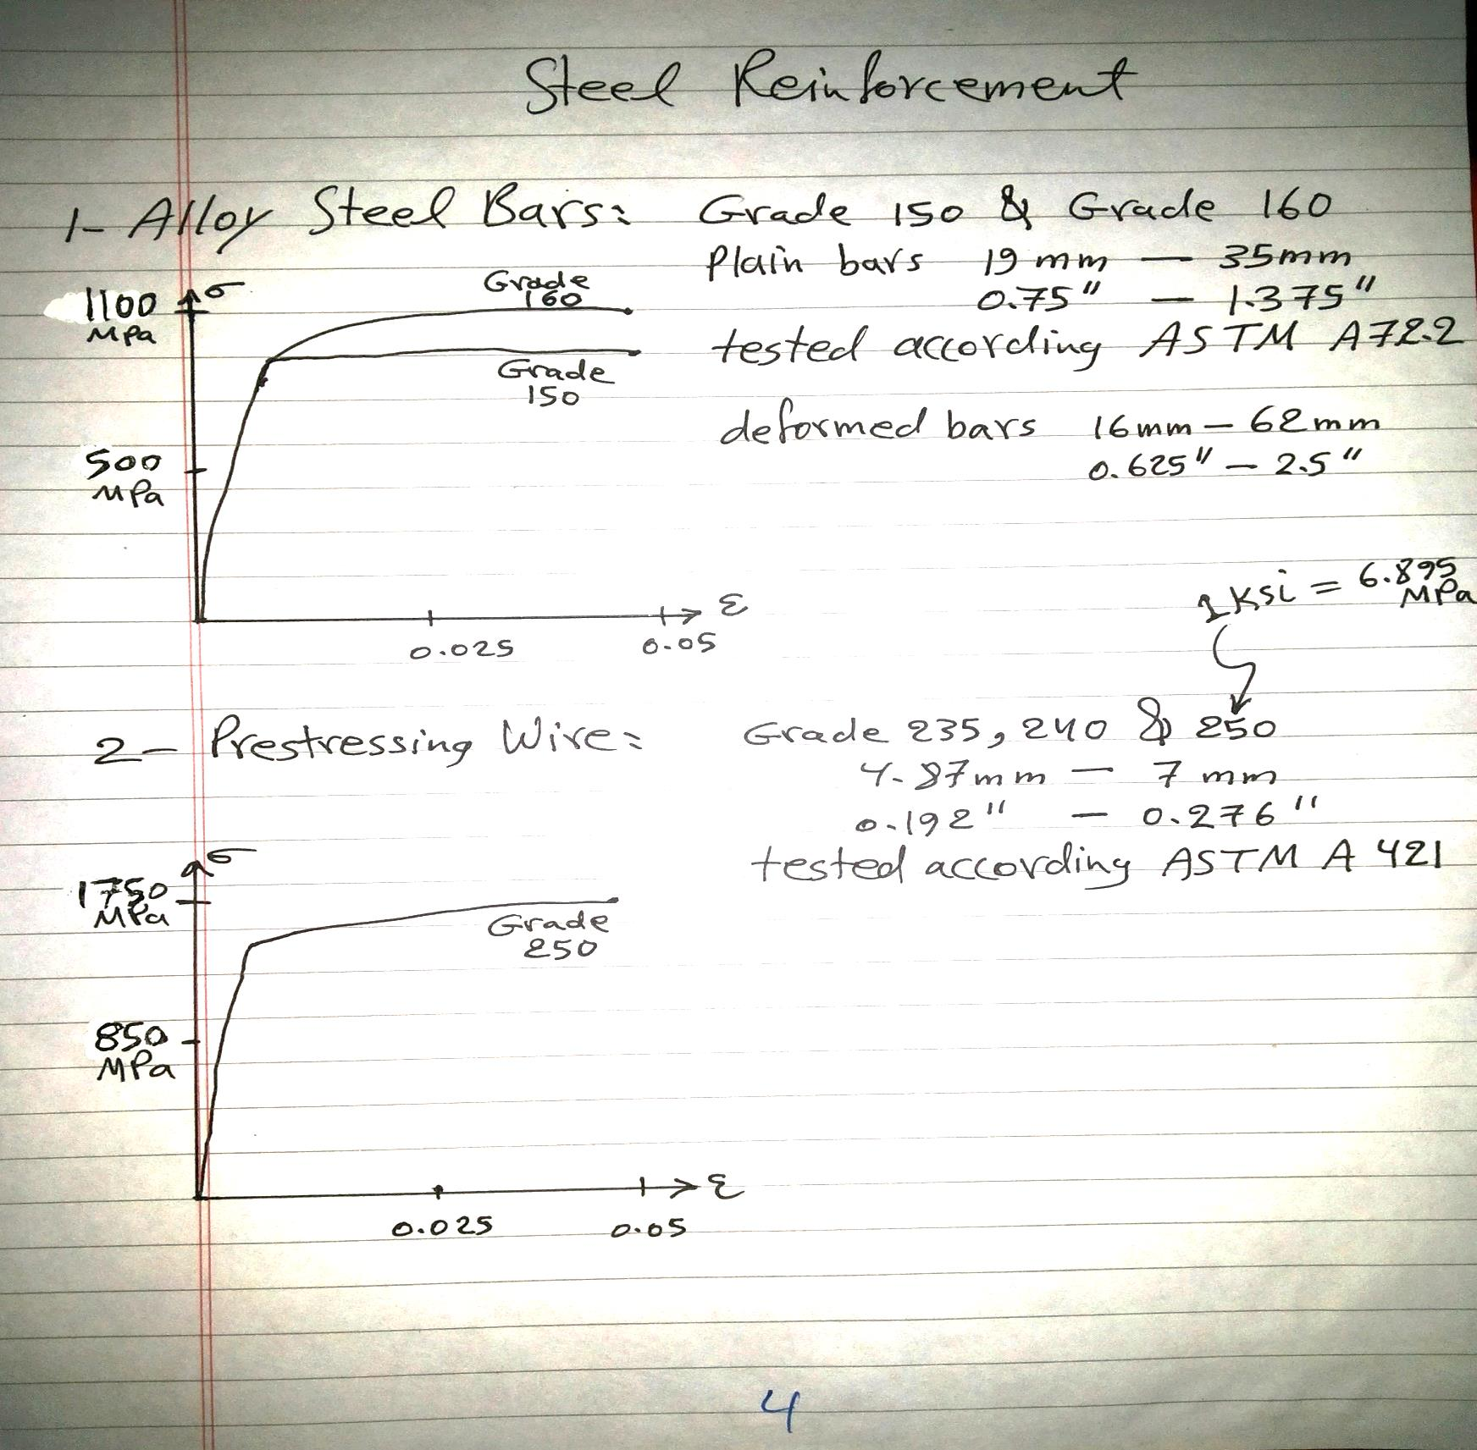

Slide 6
